Slide 1
Artificial Intelligence in Finance Project

Slide 2
Project topic & Seed programs
The project chosen is: Explain and extend a case model in: Machine Learning and Data Science Blueprints for finance by Tatsat for the final project. The case model we will explain and extend is case study 1: Stock Price Prediction from Chapter 5 Supervised Learning: Regression.
The seed programs we used for our project is under the repository fin-ml/Chapter 5 - Sup. Learning - Regression and Time Series models/Case Study 1 - Stock Price Prediction/ from Github of Hariom Tatsat.
The link for this seed program: https://github.com/tatsath/fin-ml/blob/master/Chapter%205%20-%20Sup.%20Learning%20-%20Regression%20and%20Time%20Series%20models/Case%20Study%201%20-%20Stock%20Price%20Prediction/StockPricePrediction.ipynb

Slide 3
Sources of Data
The database we used to download our data is WRDS, the Wharton Research Data Services.
The link for the database:
https://wrds-www.wharton.upenn.edu/pages/get-data/nyse-trade-and-quote/millisecond-trade-and-quote-daily-product-2003-present-updated-daily/consolidated-trades/
We downloaded data for IBM, GOOGL, MSFT, ETF data for Dow Jones, S&P 500, VIX and currencies data for USD/JPY and GDP/USD. The period we used is from 2018/01/01 to 2018/12/31. A one year period provides enough data for our program to process.
We processed our data using WRDSHourlyDataProcessing.py, WRDSHourlyDataProcessing_OPEN.py,WRDSHourlyDataProcessing_HIGH.py and WRDSHourlyDataProcessing_LOW.py from lecture to obtain hourly data results.
We named our data csv IBM_result.csv, GOOGLE_result.csv, MSFT_result.csv, dia_result.csv, SPY_result.csv, vixy_result.csv, fxy_result.csv, fxb_result.csv, MSFT_OPEN.csv, MSFT_LOW.csv and MSFT_HIGH.csv.

Slide 4
List of improvements
1. Apply model to new data (frequency)
- We applied model to WRDS Hourly data including: GOOGL, IBM, MSFT open, MSFT close, MSFT high, MSFT low, ETF data for Dow Jones, S&P 500, VIX , currencies data for USD/JPY, currencies data GDP/USD.
2. Include new indicator inputs
- Talib features, smoothing features: wavelets, lags
3. Include more model parameter grids during cross validation
- Added SVR, SVC, PCA, wavelets parameter grids
4. Used scikit-learn and ta-lib (=parametrized features) move the feature parameter choice to a function inside the pipeline
5. Answered questions at the end of chapters in Tatsat's book
6. Replace a model with a more advanced version of the same model

Slide 5
Inputs and Target
Inputs:
IBM
GOOGL
MSFT open
MSFT close
MSFT high
MSFT low
ETF data for Dow Jones
S&P 500
VIX
Currencies data for USD/JPY
Currencies data GDP/USD
Target:
MSFT future returns
We have downloaded the data from WRDS website: https://wrds-www.wharton.upenn.edu/pages/get-data/nyse-trade-and-quote/millisecond-trade-and-quote-daily-product-2003-present-updated-daily/consolidated-quotes/
The timeframe for the data is from 2018/01/01 to 2018/12/31, and the frequency is hourly.

Slide 6
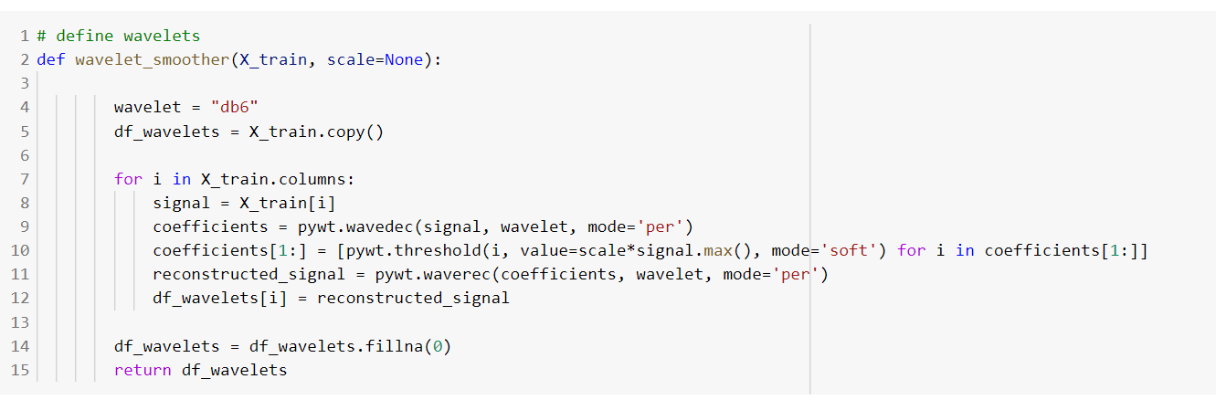
Input Processing
We have covered wavelets in the LinearSVC model in our program.

Slide 7
Input Selection or Extraction
pca=PCA()
pipe = Pipeline([('scaler',scaler), ('pca', pca),('svc', svc)])
ncomponents_rs = list(range(10,X_test.shape[1]))
param_grid = [{'pca__n_components':ncomponents_rs, 'svc__C': c_rs}]
We have used PCA for input selection and features extraction.

Slide 8
Models Used
The models used for this project include:
Linear Regression
Lasso
Elastic Net
KNeighborsRegressor
DecisionTreeRegressor
MLPregressor
AdaBoostRegressor
GradientBoostingRegressor
RandomForestRegressor
ExtraTreesRegressor
LinearSVR
LinearSVC

Slide 9
Model Parameters
The model parameters for LinearSVR are:
param_grid_LinearSVR = [{'pca__n_components':ncomponents_rs_LinearSVR, 'svr__C': c_rs_LinearSVR, 'svr__epsilon': epsilon_rs_LinearSVR}]
The model parameters for LinearSVC are:
param_grid = [{'pca__n_components':ncomponents_rs, 'svc__C': c_rs}]

Slide 10
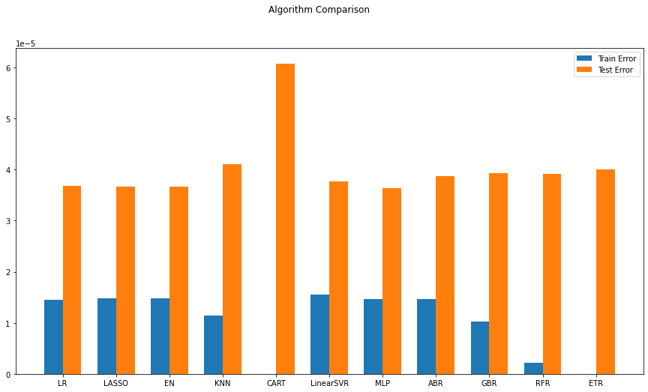
Model Performance
In the plot of Algorithm Comparison, the train error and test error of all the models are compared.
Examining the training and test error, we could see a stronger performance from the linear models. Among the linear models, linear SVM regression seems to perform best. Linear SVMs are also more robust (not as vulnerable to outliers) and faster trainers, so we select LinearSVR for further model tuning and compare it with LinearSVC, in order to make a comparison between regression and classification.

Slide 11
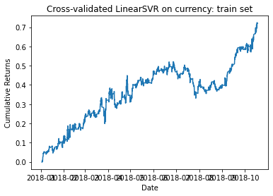
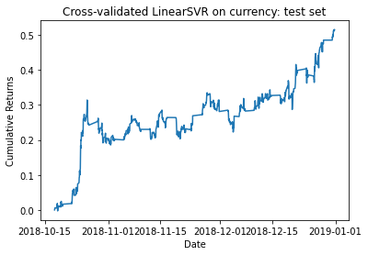
Equity Curves for LinearSVR

Slide 12
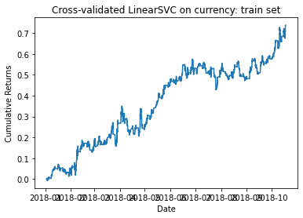
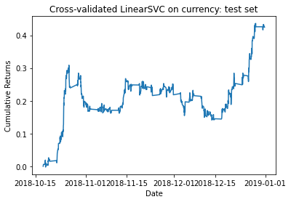
Equity Curves for LinearSVC

Slide 13
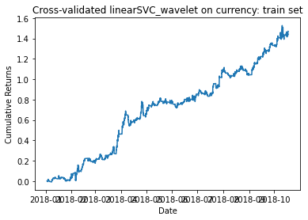
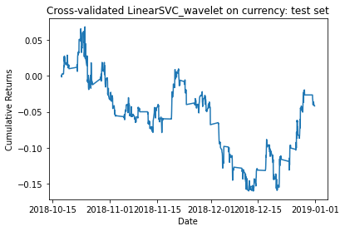
Equity Curves for LinearSVC with wavelets

Slide 14
Statistical & Financial Metrics
The financial metrics for LinearSVR are:
In-sample: CAGR=0.0410983 Sharpe ratio=0.691297 maxDD=-0.124226 maxDDD=938 Calmar ratio=0.330836
Out-of-sample: CAGR=0.131052 Sharpe ratio=1.33326 maxDD=-0.097679 maxDDD=355 Calmar ratio=1.34166 Rho=0.107173 PVal=0.00176489 MSE=3.64218e-05
The financial metrics for LinearSVC are:
In-sample: CAGR=0.041849 Sharpe ratio=0.703134 maxDD=-0.107667 maxDDD=845 Calmar ratio=0.388689
Out-of-sample: CAGR=0.110771 Sharpe ratio=1.14333 maxDD=-0.127992 maxDDD=678 Calmar ratio=0.865459 accuracy_score=0.542992
The financial metrics for LinearSVC with wavelets are:
In-sample: CAGR=0.0694158 Sharpe ratio=1.1333 maxDD=-0.0872723 maxDDD=352 Calmar ratio=0.795393
Out-of-sample: CAGR=-0.0126269 Sharpe ratio=-0.0840197 maxDD=-0.213068 maxDDD=764 Calmar ratio=-0.0592622 accuracy_score=0.504122

Slide 15
Statistical & Financial Metrics Comparisons
 | LinearSVR | LinearSVC | LinearSVC w/ wavelets
CAGR | 0.131052 | 0.110771 | -0.0126269
Sharpe Ratio | 1.33326 | 1.14333 | -0.0840197
P-value | 0.0114 | 0.0282 | 0.4310
If reject Ho | Reject Ho | Reject Ho | Do not reject Ho
Statistical metrics (accuracy/mse) | MSE=3.64218e-05 | accuracy_score=0.542992 | accuracy_score=0.504122

Slide 16
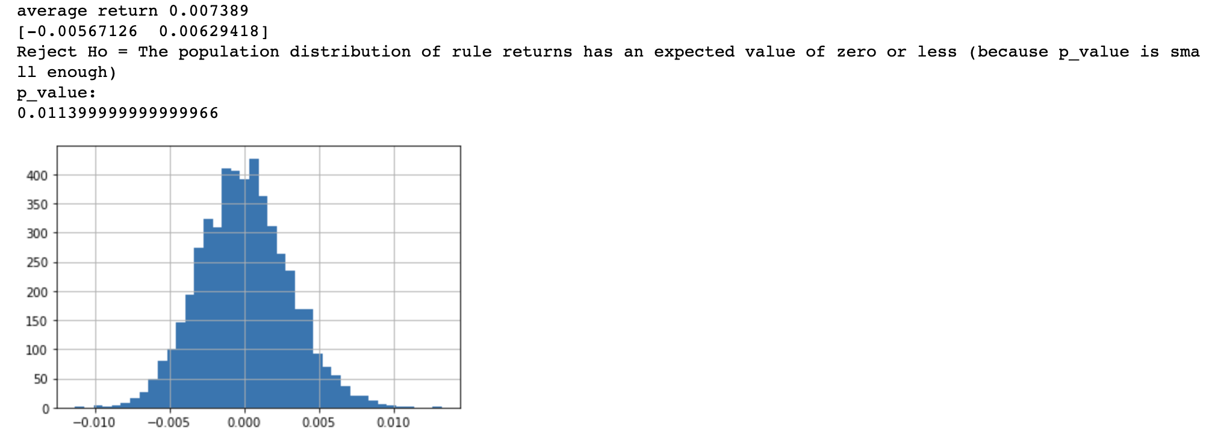
Final White Reality Check for LinearSVR

Slide 17
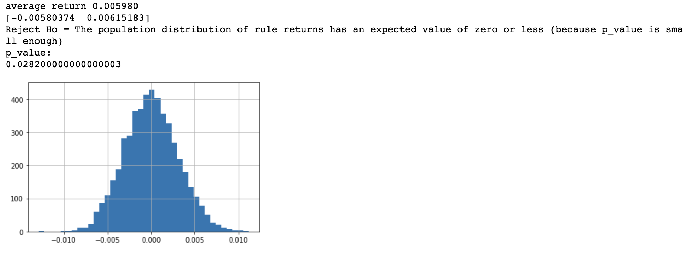
Final White Reality Check for LinearSVC

Slide 18
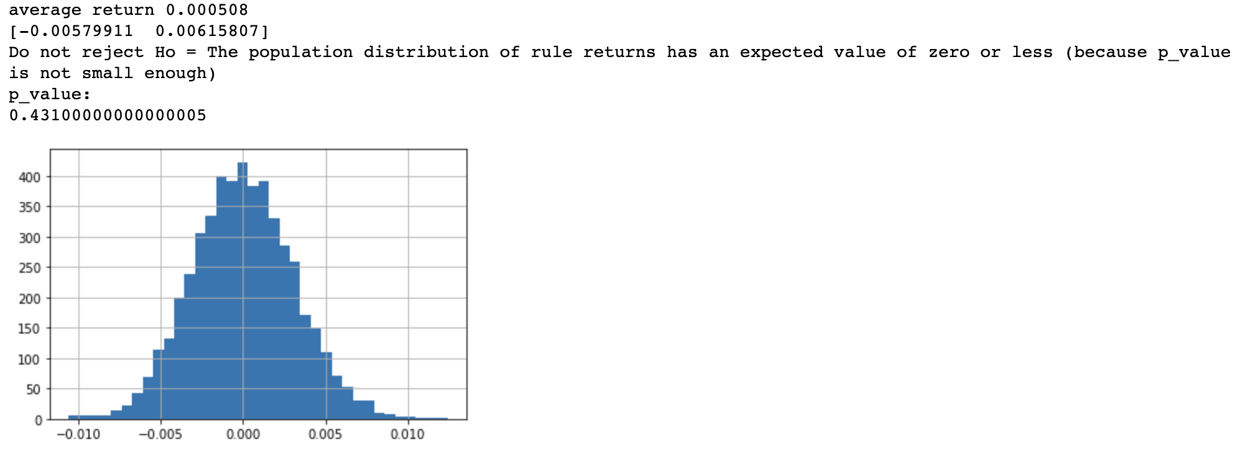
Final White Reality Check for LinearSVC with wavelets

Slide 19
White Reality Check Results Comparison
From the results returned for the White Reality Check, the LinearSVR model has an average return of 0.007389 while the LinearSVC model has an average return of 0.005980 and the LinearSVC with wavelets model has an average return of 0.000508.
The LinearSVR model has a p-value of 0.0114 while the LinearSVC model has a p-value of 0.0282 and the LinearSVC with wavelets has a p-value of 0.4310. The LinearSVR model’s p-value is significantly smaller than the p-value of the LinearSVC model and the LinearSVC with wavelets. Therefore, we prefer to use the LinearSVR model.

Slide 20
Conclusion
From the results above, we can conclude that linear SVMs are promising modeling approaches for stock price prediction problems, and LinearSVR outperforms LinearSVC in this case. Also, we found that wavelets did not improve the performance of our linearSVC model. Therefore, we should not apply waveltes to our LinearSVMs model and finalize our best model as LinearSVR(C=0.0001, epsilon=0) with StandardScaler and PCA(n_components=12) applied.

Slide 21
Thanks for watching!

